Slide 1


Mobile Phone Security
Dr. Digvijaysinh Rathod
Associate Professor
(Cyber Security and Digital Forensics)
Institute of Forensic Science
Gujarat Forensic Sciences University
digvijay.rathod@gfsu.edu.in

Slide 2
BroadcastReceiver
system-generated intents
classes of broadcasts
implementation of broadcast receivers
Dr. Digvijaysinh Rathod

Slide 3
Reference
www.developer.google.com
https://data-flair.training/blogs
https://alignminds.com
digvijay.rathod@gfsu.edu.in

Slide 4
What is Android Broadcast Receiver?
Android Broadcast Receiver is an Android component that is used to broadcast the messages to the system or other applications or
Android Broadcast Receiver is a component that responds to the system’s wide broadcast announcements.
Dr. Digvijaysinh Rathod

Slide 5
What is Android Broadcast Receiver?
A broadcast receiver is a dormant component of the Android system.
Only an Intent (for which it is registered) can bring it into action.
The Broadcast Receiver’s job is to pass a notification to the user, in case a specific event occurs.
Using a Broadcast Receiver, applications can register for a particular event.
Once the event occurs, the system will notify all the registered applications.
Dr. Digvijaysinh Rathod

Slide 6
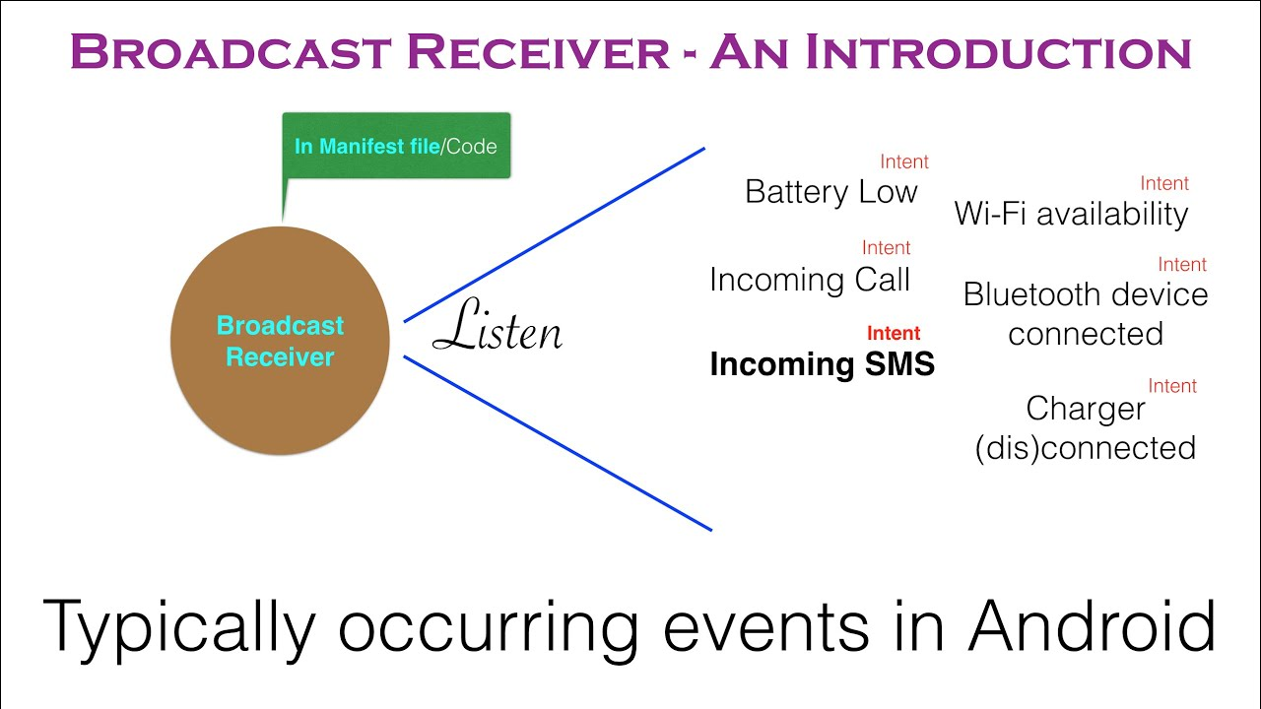
What is Android Broadcast Receiver?
It’s used for Asynchronous Inter-Process communication.
Dr. Digvijaysinh Rathod

Slide 7
What is Android Broadcast Receiver?
Some Android broadcast receiver examples –
low battery notification in the notification bar by the system
notification to other applications when something downloads, so they can use it when required.
Dr. Digvijaysinh Rathod

Slide 8
What is Android Broadcast Receiver?
It can be registered for various system or application events.
Whenever those events occur the system notifies all the registered broadcast receivers and then the desired action is being done.
Broadcast originates from the system as well as applications.
Dr. Digvijaysinh Rathod

Slide 9
What is Android Broadcast Receiver?
Like the alarm notification, low battery notification etc. are the example of broadcast originating from the system.
While getting the push notifications for desired application describes the example for broadcast originating from the application.
Dr. Digvijaysinh Rathod

Slide 10
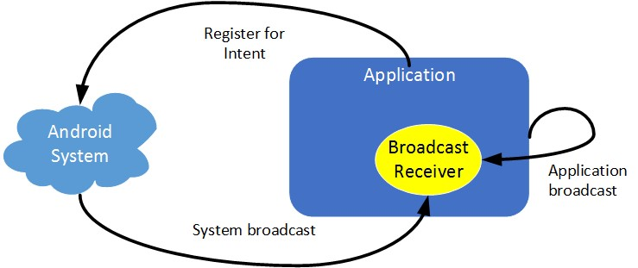
What is Android Broadcast Receiver?
Using a Broadcast Receiver, applications can register for a particular event using intent. Once the event occurs, the system will notify all the registered applications.
Dr. Digvijaysinh Rathod

Slide 11
What is Android Broadcast Receiver?
For instance, a Broadcast receiver triggers battery Low notification that you see on your mobile screen.
Other instances caused by a Broadcast Receiver are new friend notifications, new friend feeds, new message etc. on your Facebook app. In fact, you see broadcast receivers at work all the time.
Notifications like incoming messages, WiFi Activated/Deactivated message etc. are all real-time announcements of what is happening in the Android system and the applications.
Dr. Digvijaysinh Rathod

Slide 12
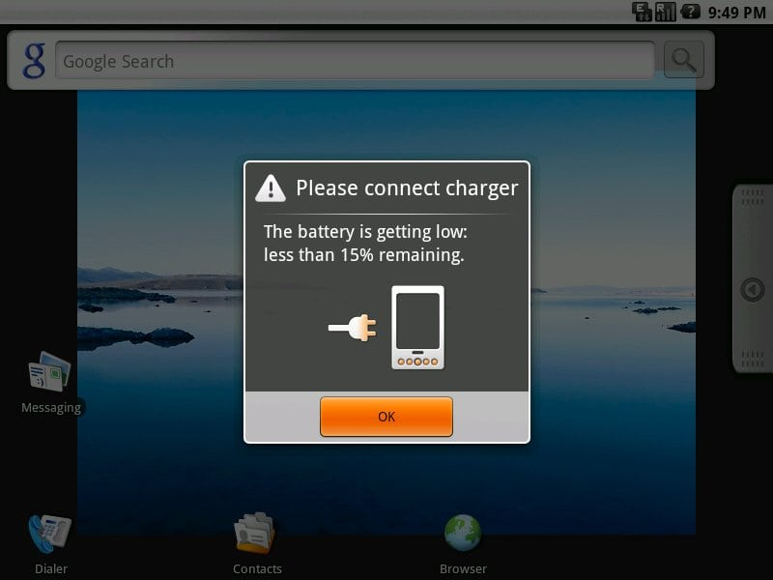
What is Android Broadcast Receiver?
Dr. Digvijaysinh Rathod

Slide 13
System-generated Intents
Consider this:
You have an important social gathering to attend. Because of your shoddy memory, you have requested your friend to notify you a day before the event.
Now, because you have ‘registered’ for the said friend’s help, you will get a reminder from him as discussed. This is roughly how the Broadcast Receiver works.
Dr. Digvijaysinh Rathod

Slide 14
How important is it to implement Broadcast Receivers correctly?
If you wish to create a good Android application, this is of utmost importance.
If the broadcast events do not perform their job (of sending notifications to support the application’s primary task) perfectly, the application would not be intuitive and user friendly.
Dr. Digvijaysinh Rathod

Slide 15
Registration of Broadcast Receiver
There are two ways to register a Broadcast Receiver; one is Static and the other Dynamic.
1) Static: Use <receiver> tag in your Manifest file. (AndroidManifest.xml)
2) Dynamic: Use Context.registerReceiver () method to dynamically register an instance.
Dr. Digvijaysinh Rathod

Slide 16
Classes of Broadcasts
The two major classes of broadcasts are:
1) Ordered Broadcasts:
These broadcasts are synchronous, and therefore follow a specific order.
In ordered mode, broadcasts are sent to each receiver in order (controlled by the android:priority attribute for the intent-filter element in the manifest file that is related to your receiver)
Dr. Digvijaysinh Rathod

Slide 17
Classes of Broadcasts
1) Ordered Broadcasts:
and one receiver is able to abort the broadcast so that receivers with a lower priority would not receive it (thus never execute).
The receivers with greater priority would receive the broadcast first.
Dr. Digvijaysinh Rathod

Slide 18
Classes of Broadcasts
1) Ordered Broadcasts:
Each receiver (when it receives the broadcast) can either pass on the notification to the next one, or abort the broadcast completely.
On abort, the notification would not be passed on to the receivers next in line.
An example of this type of broadcast (and one that will be discussing in this document) is the ACTION_NEW_OUTGOING_CALL one.
Dr. Digvijaysinh Rathod

Slide 19
Classes of Broadcasts
The two major classes of broadcasts are:
2) Normal Broadcasts:
In non-ordered mode, broadcasts are sent to all interested receivers “at the same time”.
Normal broadcasts are not orderly.
Therefore, the registered receivers often run all at the same time.
This is very efficient, but the Receivers are unable to utilize the results.
Dr. Digvijaysinh Rathod

Slide 20
Classes of Broadcasts
The two major classes of broadcasts are:
2) Normal Broadcasts:
One example of such broadcast is the ACTION_BATTERY_LOW one.
Dr. Digvijaysinh Rathod

Slide 21
System-generated Intents
Let us see some system-generated Intents which are important and are generally used:
android.intent.action.POWER_DISCONNECTED – The power is disconnected from the device.
android.intent.action.BOOT_COMPLETED – This broadcast is shown only once when the device boots for the first time.
android.intent.action.CALL – This intent is to perform a call to some specific person, according to data.
android.intent.action.DATE_CHANGED – This means the date of the device has changed.
Dr. Digvijaysinh Rathod

Slide 22
System-generated Intents
Let us see some system-generated Intents which are important and are generally used:
android.intent.action.REBOOT – This means that the device has rebooted.
android.intent.action.CONNECTIVITY_CHANGE – This shows the network connectivity of the device has changed.
android.intent.action.BUG_REPORT – This reports the bugs if there is any.
android.intent.action.CALL_BUTTON – The user pressed the call button to make a call, which takes them to an appropriate user interface.
Dr. Digvijaysinh Rathod

Slide 23
Broadcasting Custom Intents
If one wants that the application itself should generate and send custom intents then one will have to create and send those intents by using the sendBroadcast() method inside the activity class.
Dr. Digvijaysinh Rathod

